Slide 1


How do I get started in Recovery pro?
with Bill Ashland

Slide 2
Components
Getting Started – The Kickoff
Business Processes
Plan Task Checklists & Workgroup Relocation
Incident Management
Risk Assessment
Systems Recovery (if applicable)
Validation & Maintenance
Q & A

Slide 3
Getting Started – The Kickoff
The Players: Identify the Team (operational area and leaders/subject matter experts for each)
Executive Team
HR
Accounting/Finance
Operations
Member Services
Lending
Technology

Slide 4
Getting Started – The Kickoff
The Players: Identify any sub-areas within the high-level areas defined
Member Services:
Teller
Call Center
Card Services
Lending:
Mortgage Lending
Consumer Lending
Business Lending
These become the structure for identifying and capturing your Business Processes.

Slide 5
Business Processes
These are the foundations on which your planning effort is built.
Identify your business processes
The Five-by-Five Rule (hitting the right level of granularity)
Variation of the “Elevator Pitch”
Identify the essence of what each team does in roughly five business processes
Describe each process in basic terms using roughly five steps/statements
There will be some areas with more, and some with less.

Slide 6
Business Processes
These are the foundations on which your planning effort is built.
Accounting/Finance:
Accounts Payable
Data Processing
General Ledger Reconciliation
Financial Reporting
Asset and Liability Management (ALM)

Slide 7
Business Processes
These are the foundations on which your planning effort is built.
For Each Process:
Contacts – who is the leader or SME for this process
Workflows – process description, timing (if applicable), inputs, steps, outputs
Dependencies – process dependencies, physical dependencies, system dependencies
Impact Scoring and Maximum Allowable Downtimes (M.A.D.)
Event types – facility, systems, people
Categories – customer, financial, legal/regulatory, reputational, data loss
These become your BIA Scores, RTOs, and RPOs; your Business Impact Analysis

Slide 8
Business Processes
These are the foundations on which your planning effort is built.
For Each Process:
For each event type (facility, systems, people)
Recovery Strategies - actions
Considerations - information or concerns
Resource Needs – needs (other than PCs, phones)
Once complete, you will have a concise view for each business process – how much it will hurt if it is interrupted, how soon you need to resume it, and how you will do so.

Slide 9
Business Processes
These are the foundations on which your planning effort is built.
How to build this content:
Option ONE – use the existing templates in Recovery Pro, editing and adding new ones as needed
Option TWO – utilize a workbook to make the data collection easier. The Recovery Pro support staff can assist with the initial formatting and import of the completed information into Recovery Pro
There are more than 40 business processes already in the Sample Content
The Resources area also includes sample workbook and word merge templates
The Content Guide provides guidance on the process, down to the individual field level in most cases.

Slide 10
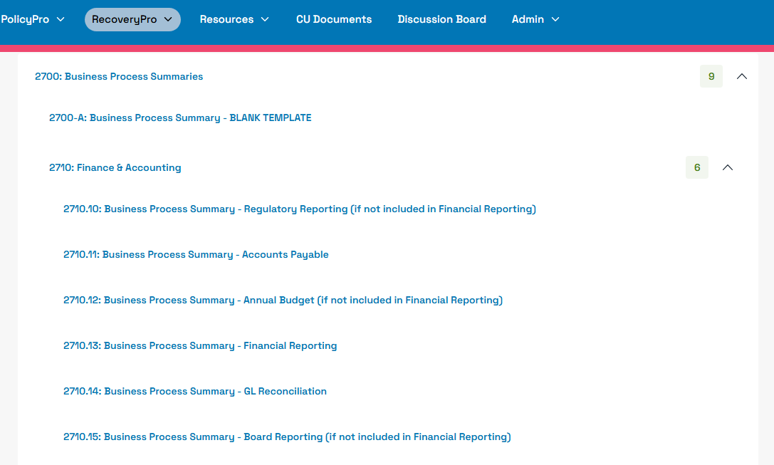
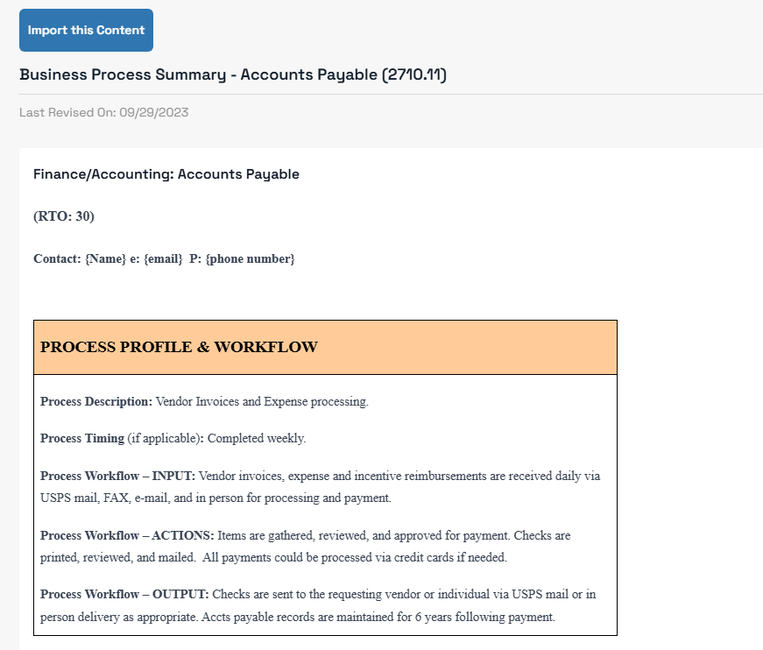

Slide 11
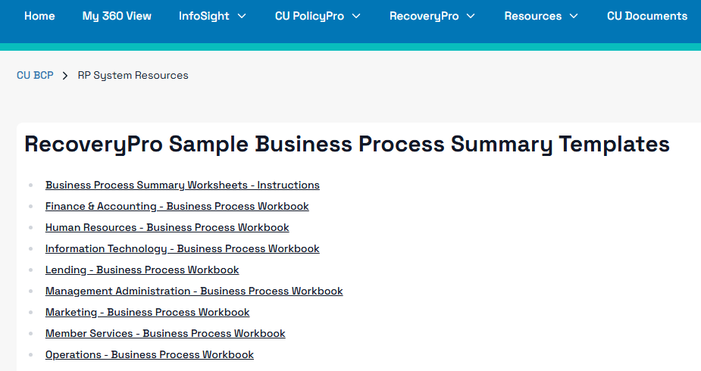
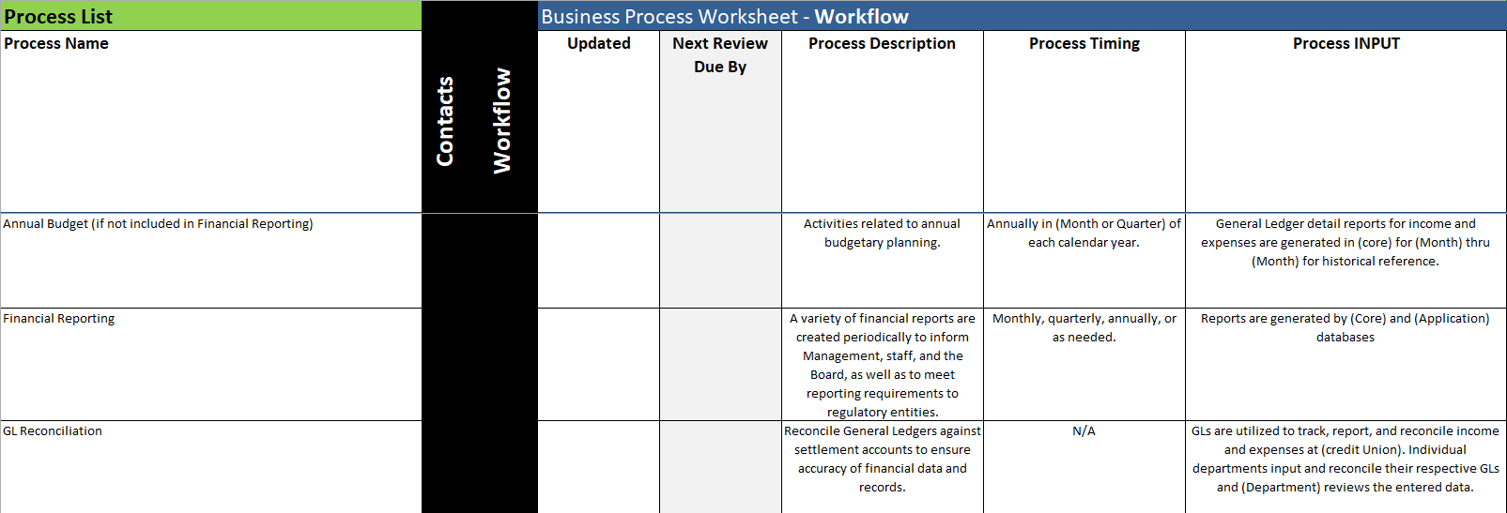

Slide 12
Plan Task Checklists and Workgroup Relocation
High-level, one-page checklists for each event type – facility, systems, people
Workgroup Recovery/Relocation worksheets (one for each location)
Roles and counts for each per facility
When staff are needed back in action over time (based on the Business Process RTOs)
What options are available for them to relocate to if their primary location was impacted:
Alternate location (internal to the CU)
Alternate location (external to the CU)
Remote work (work from home)
Mobile Recovery (3rd-party service provider)

Slide 13
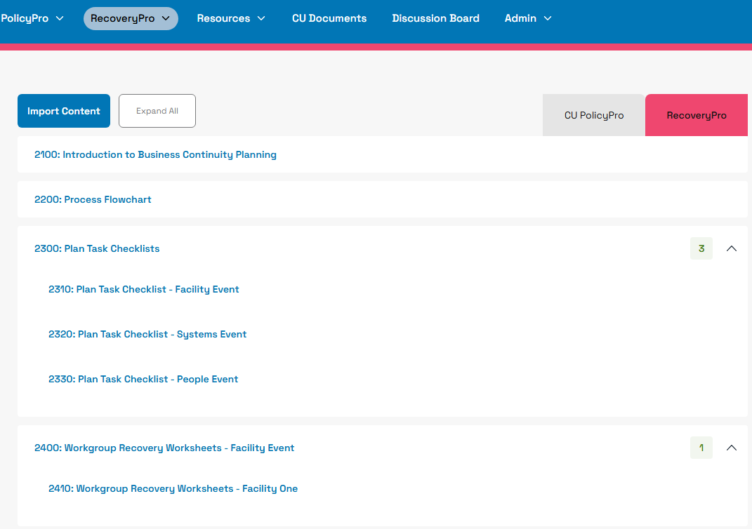
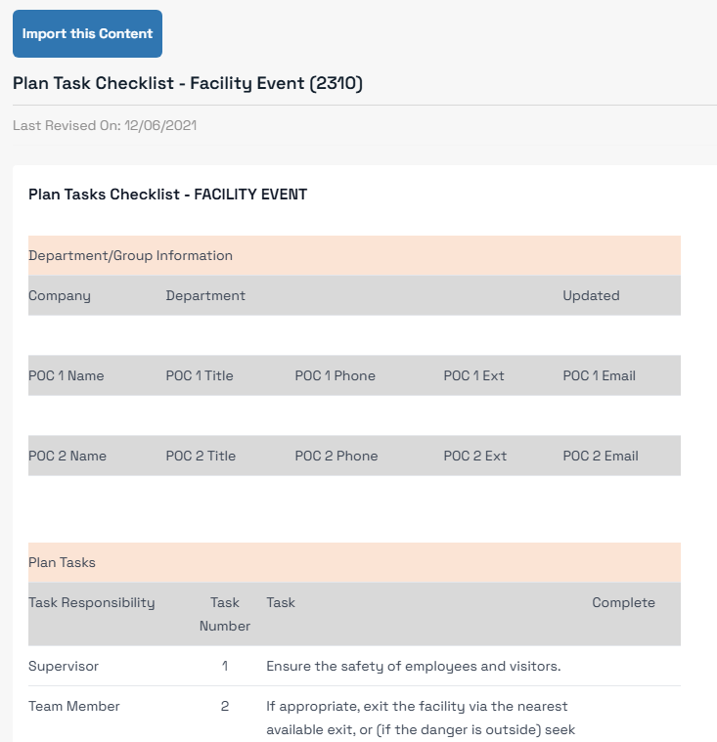

Slide 14
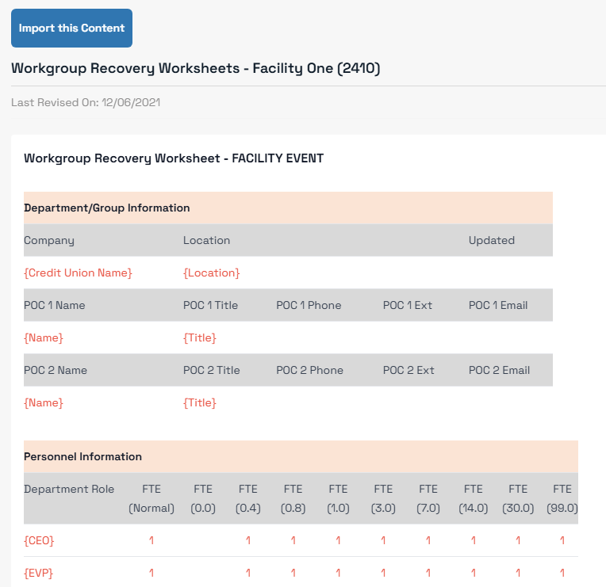

Slide 15
Incident Management
What happens BEFORE you activate your BCP
Roles and responsibilities:
Decision-making authority
Business continuity order of succession
Incident Management Team
Notification/Escalation
Call tree
Key Vendor Contacts
NEW (expanded) Cyber-Incident Content
NCUA guidance, tools, covers all phases of the process

Slide 16
Incident Management
What happens BEFORE you activate your BCP
Command Center:
Primary
Secondary
(Optional) Tertiary
Incident Monitoring
News and information sources
Mechanisms for data flow INTO the command center (internal)

Slide 17
Incident Management
What happens BEFORE you activate your BCP
Communications:
Primary Spokesperson
Secondary Spokesperson
Communications Templates
Resources:
Emergency wallet cards
Any other information you would like included – terms, web links, etc.)
Procedures:
Emergency procedures (general, for staff, and for specific events)
Emergency supplies

Slide 18
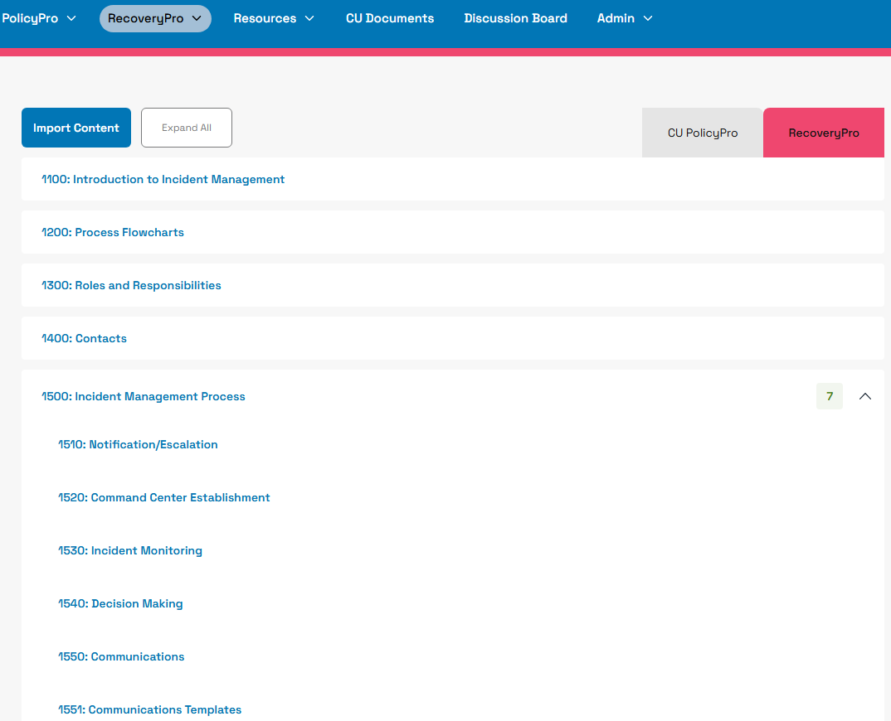
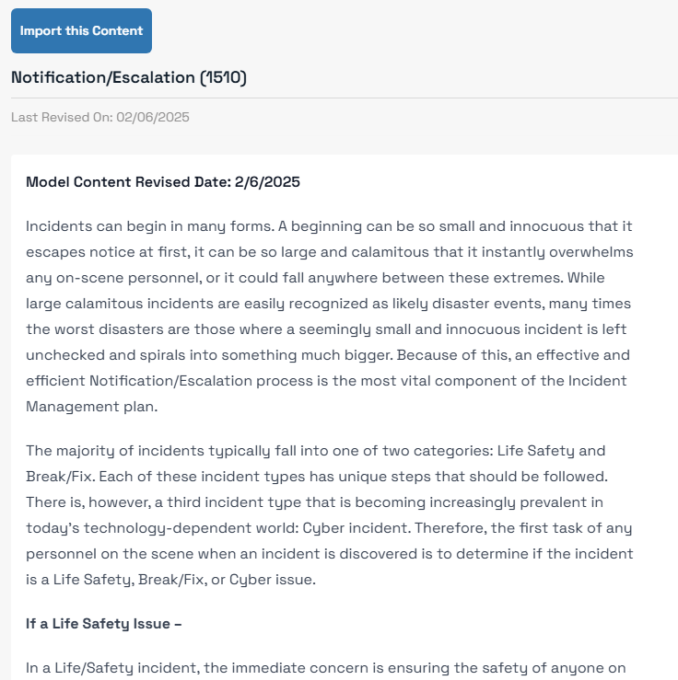

Slide 19
Risk Assessment
Goes beyond the planning basis of impacts (facility, systems, people) and into specific threats
Threats listing (and assumption)
Planning Impacts (facility, systems, people)
Probability Rating (and details)
Impact Rating (and details)
NEW Velocity (Speed of Onset)
Initial Risk Score and Risk Rating (formula driven)
Mitigating Factors (controls)
Residual Risk Rating (objective)
Gap Analysis (additional things that could be done to further reduce risk)
There is rumored to be a workbook that will help with this also. ☺

Slide 20
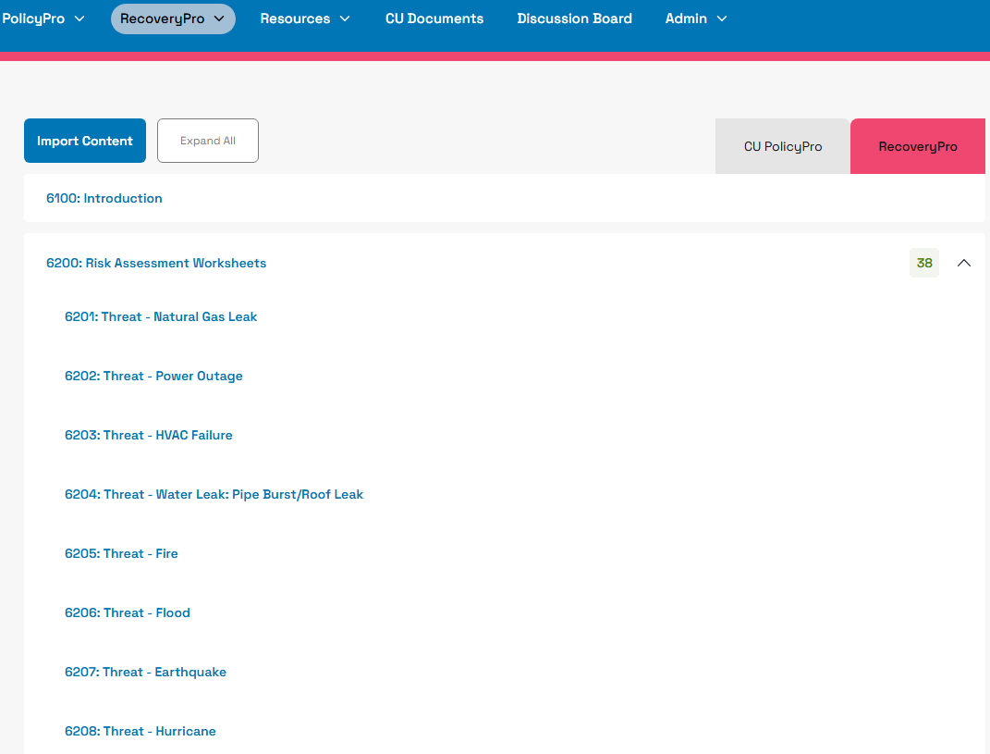
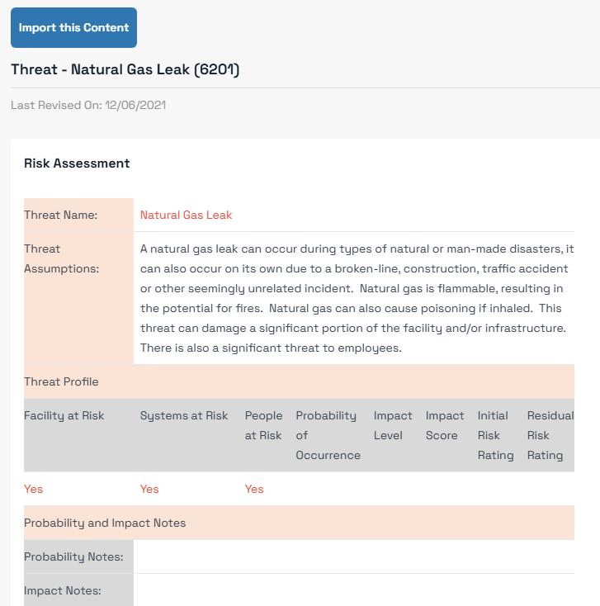

Slide 21
Systems Recovery (if applicable)
If this process is completed internally by CU staff:
Systems Recovery Technical Process (SRTP) – detailed information for each system or infrastructure component recovery
Systems Recovery Sequencing (a.K.a. DR Sequencing) – how the individual SRTPs are sequenced to most effectively support the RTOs of critical business processes

Slide 22
Validation and Maintenance
Keeping plans current, validating their effectiveness, and applying lessons learned
Orientation/Walkthrough Exercise – review documentation and how it is used with staff
Tabletop Exercises –
Facility Event
Systems Event
People Event
Data Compromise Event
Functional Exercises – practiced testing of BCP and/or Systems Recovery components
Scaled Exercises – combined testing of multiple BCP and/or Systems Recovery components

Slide 23
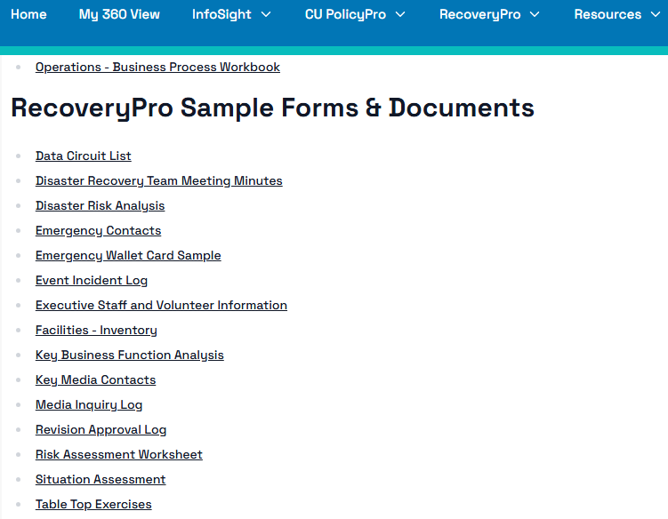
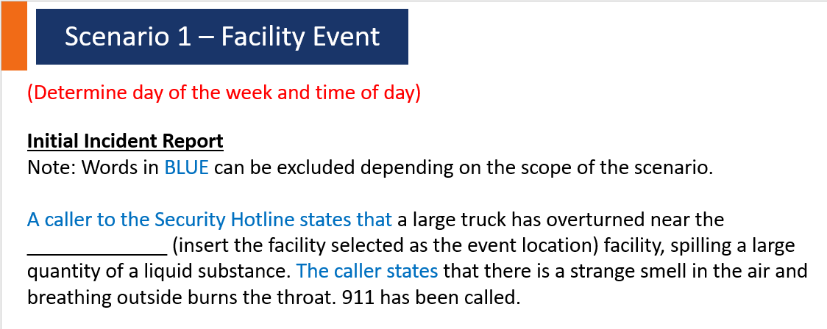

Slide 24
Validation and Maintenance
Keeping plans current, validating their effectiveness, and applying lessons learned
Controls Testing –
Identify known controls that may or may not be associated with BCP
Identify additional controls from the mitigation factors identified in the Risk Assessment that can be (or could be) tested.
Maintenance –
Annual (at a minimum) reviews and updates to plan content, or as there are changes
Applying lessons learned from testing and/or actual events
Addition of new content
Publishing and distributing the updated plans

Slide 25
Q & A
Who has questions?
Contact Info:
Bill Ashland
AVP, Business Continuity
Synergent
washland@synergentcorp.com
Questions can also be sent to info@infosight360.com!
Thank YOU!

